Slide 1

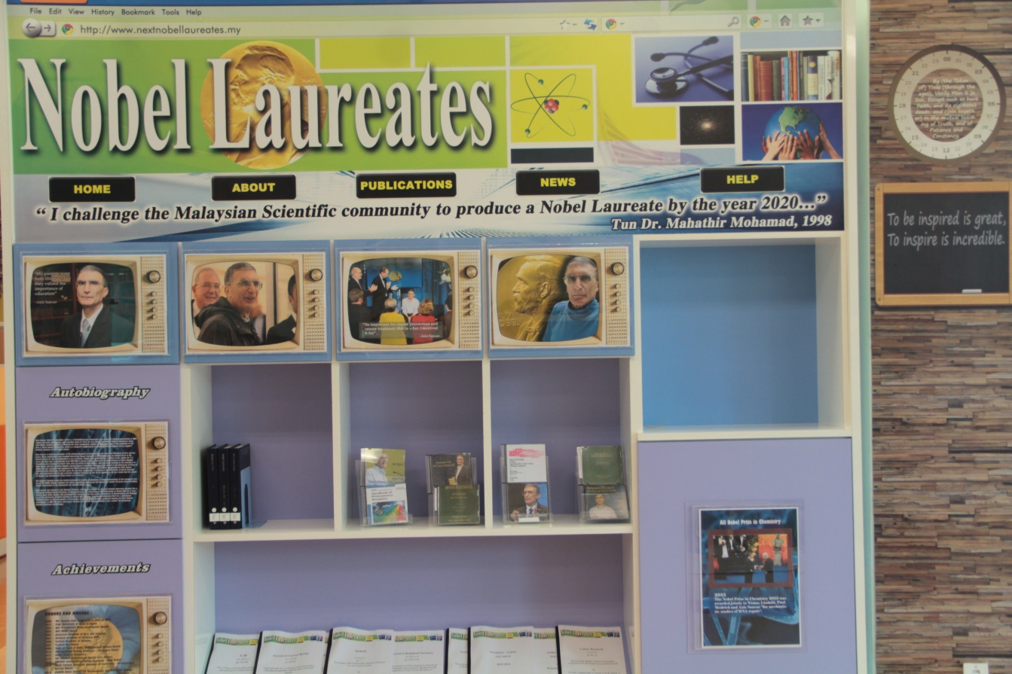
UNIVERSITI MALAYSIA PERLIS
Nobel Laureates @ Perpustakaan Tuanku Syed Faizuddin Putra, Kampus Pauh Putra
© Copyright Perpustakaan Tuanku Syed Faizuddin Putra
© Copyright Perpustakaan Tuanku Syed Faizuddin Putra

