Slide 1
Towards Next Generation Repositories
Kazu YAMAJI
With significant input from Andrea Bollini, Petr Knoth, Eloy Rodrigues, Kathleen Shearer, Herbert Van de Sompel, Paul Walk, David Wilcox, and the COAR NGR Working Group

Slide 2

COAR’s Vision
A global knowledge commons based on a network of open access repositories

Slide 3
Who is COAR?
An international association founded in 2009
Members & Partners: over 120 institutions from 35 countries in Africa, Asia, Australasia, Europe, North and South America
Objectives:
Strategic voice for repositories
Interoperability and alignment across repositories and regional networks
Capacity building
Support the development of value added services
Notes:
COAR is the abbreviation of confederation of open repositories which established in 2009.
The COAR office is based in Gottingen, Germany and it is a very light weight organization.
We are funded through membership fees – which are 500 Euros per year, and some grant funding as well.
We currently have members and partners from around the world and working to build our membership base.
We have very low membership fees to enable institutions from all regions and countries around the world to be able to participate.
Objective of COAR are

Slide 4
What is about Repository
Clifford Lynch (2003)
  a set of services that a university offers to the members of its community for the management and dissemination of digital materials created by the institution and its community members
Jisc (2016)
  A repository is a set of services[1] that a research organisation[2] offers[3] to the members of its community[4] for the management and dissemination[5] of digital materials[6] created by its community members (Provide detailed definition from 1 to 6)
Herbert Van de Sompel (2016)
  The purpose/mission of repositories is no longer well defined and has IMO to quite an extent drifted since their original inception from being about "all kinds of digital materials created by an institution's staff" to "formally published materials created by an institution's staff". In this drift lies (IMO) one of the major problems of many current IRs: they don't provide a service to their local community…
Notes:
Not only NGR activity, I can see several activity which is trying to re-think about repository.
Words from Cliff is sometimes refer to as the original definition of the repository.
And recently Jisc is provides detailed definition according to the current situation maybe by explaining what is the service, research organization, offer community, dissemination and materials.
Herbert said in our early discussion between NGR guys that in the original idea, repository possibly covers all kinds of digital materials created by an institution’s staff, however in the most of the case it just handle formally published materials created by an institution staff.

Slide 5


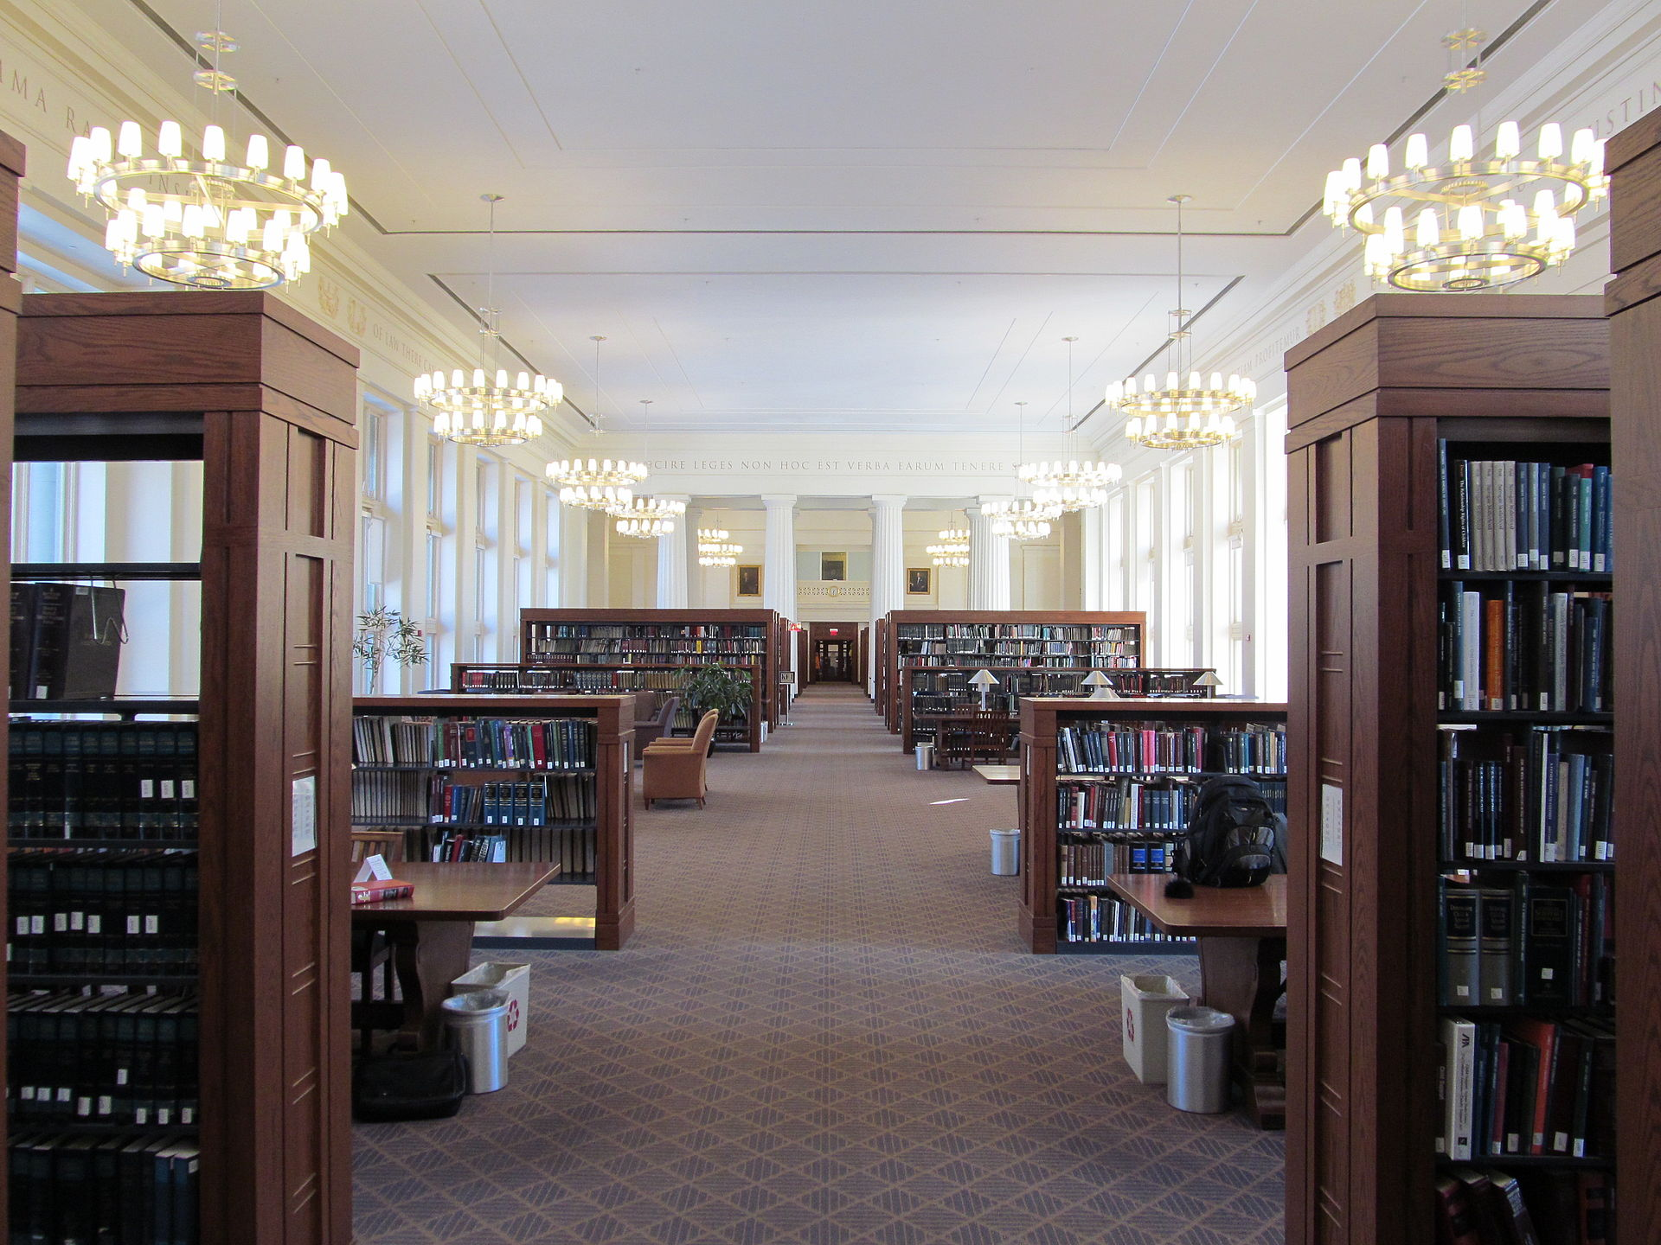


Your Thought ?
Self-archive Green OA
Gold OA with Repository
OAI-PMH
Notes:
How do you think about this.
Of course as you know, the repository activity itself has been started in terms of serial crises then try to demonstrate and propagate self-archiving green OA activity.
However at this moment, as a Japanese situation, only the certain level and size of university are still collecting the green way but most of the middle and small institution cannot afford good enough time to do so.
And then even though the e-resource contract is now dramatically changing to the gold but repository community does not discuss and prepare deeply about this, in case of Japan.

Slide 6
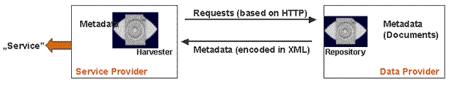
Why Now ?
Common Standard for Repository Network
only OAI-PMH
  Background
    Create New Scholarly Communication
      by Pre-Print: arXiv
    Based on Web-Technology around 90’s
  Behavior
    Metadata Aggregation by Machine
    Pull Action from Service Provider (Aggregator)
Notes:
Everybody know about OAI-PMH.
It is a protocol aggregating metadata from repository to service provider such as discovery service.
Is is widely used in the repository community but I can say it is only one technology and community that each repository must have.
However, if we look at recent internet technology, google stops OAI-PMH metadata aggregation for a long time ago and it is only our protocol.
Historically it is the protocol to try to create new scholarly communication world based on the preprint service named arXiv.
And it is based on the web-technology around 90’s.
Behavior of OAH-PMH is … and ….
But now a days, as you are experiencing by your smartphone, in the most of the case, action is push from data provider in order to ensure dynamic communication.

Slide 7
Next Generation Repositories
Major strategic priority for COAR
Working Group launched in April 2016
The problem: Repositories have not fully realized their potential and function mainly as passive, silo’ed recipients of the final versions of their users’ conventionally published research outputs
Aim: to identify functionalities and architectures for the next generation repositories within the context of scholarly communication
Notes:
NGR is the major strategic priority for COAR and its launched in 2 years ago.
Major concern of NGR try to solve is that repositories …
In order to solve this problem, we aimed to identify…

Slide 8
Next Generation Repositories Working Group, 2016-2017
Eloy Rodrigues, chair (COAR, Portugal) Andrea Bollini (4Science, Italy) Alberto Cabezas (LA Referencia, Chile) Donatella Castelli (OpenAIRE/CNR, Italy) Les Carr (Southampton University, UK) Leslie Chan (University of Toronto at Scarborough, Canada) Chuck Humphrey (Portage, Canada) Rick Johnson (SHARE/University of Notre Dame, US) Petr Knoth (Open University, Jisc, UK) Paolo Manghi (CNR, Italy) | Lazarus Matizirofa (NRF, South Africa) Pandelis Perakakis (Open Scholar, Spain) Jochen Schirrwagen (University of Bielefeld, Germany) Daisy Selematsela (NRF, South Africa) Kathleen Shearer (COAR, Canada) Tim Smith (CERN, Switzerland) Herbert Van de Sompel (Los Alamos National Laboratory, US) Paul Walk (EDINA, UK) David Wilcox (Duraspace/Fedora, Canada) Kazu Yamaji (National Institute of Informatics, Japan)

Slide 9

Next Generation Repositories
Next Generation Repositories
Vision
To position repositories as the foundation for a distributed, globally networked infrastructure for scholarly communication, on top of which layers of value added services will be deployed, thereby transforming the system, making it more research-centric, open to and supportive of innovation, while also collectively managed by the scholarly community.
Notes:
In the different words, vision of the NGR is to position repositories, as the …

Slide 10
Characteristics of NGR
It manages and provides access to a wide diversity of resources, including published articles, pre-prints, datasets, working papers, images, software, and so on.
It is resource-centric, making resources the focus of its services and infrastructure
It is a networked repository. Cross-repository connections are established by introducing bi-directional links as a result of an interaction between resources in different repositories, or by overlay services that consume activity metadata exposed by repositories
It is machine-friendly, enabling the development of a wider range of global repository services, with less development effort
It is active and supports versioning, commenting, updating and linking across resources
Notes:
ITをNGRに置き換えて説明する。
NGR can manage variety of contents such as …
From that point of view, NGR has to be the repository centric service.
Each NGR can talk each other and then establish bi-directional links as a result of an ineraction…
Not only OAI-PMH, it have to be machine friendly.
And then finally, NGR have to be active and supports…

Slide 11
Principles of NGR, Part 1
Distribution of control – Distributed control, or governance, of scholarly resources (preprints, post-prints, research data, supporting software, etc.) and scholarly infrastructures is an important principle which underpins this work. Without this, a small number of actors can gain too much control and can establish a quasi-monopolistic position. Distributed networks are more sustainable and at less risk to buy-out or failure.
Inclusiveness and diversity – Different institutions and regions have unique and particular needs and contexts (e.g diverse language, policies and priorities). A distributed network of repositories will aim to reflect and be responsive to the different needs and contexts of different regions, disciplines and countries.
Public good – The technologies, architectures and protocols adopted in the context of the global network for repositories will be available to everyone, using global standards when that are available.
Notes:
Going in detail as a principle of NGR, it should be distribution of control.
This is the principle of the repository because distributed networks are more sustainable and at less risk to buy out by big company.
If we will operate repository at the single place, there is a risk to buy out once the operating organization fail to realize sustainable business model.
Second principle is inclusiveness and diversity.
This aims to reflect and be responsive to the difference needs and contexts.
The third one is public good to be available to everyone, using global standards.

Slide 12
Principles of NGR, Part 2
Intelligent openness and accessibility – Scholarly resources, will be made openly available and in accessible formats, whenever possible, in order increase their value and maximize their re-use for the benefit for scholarship and society.
Sustainability – Institutions and research organizations will be major participants in the global network, contributing to the long term sustainability of resources.
Interoperability – Repositories will adopt common behaviours, functionalities and standards ensuring interoperability across institutions and enabling them to engage in a common way with external service providers
Notes:
The fourth principle is the intelligent openness and accessibility, meaning that current system is less intelligent if compare our repository system with the common service in the internet.
The fifth principle is sustainability.
The operating body can contribute to the long term sustainability of resources.
This is not all about the system itself but reflect the principle of the repository itself.
The final one is the interoperability to order to create the global intelligent repository network.

Slide 13
Design Assumptions of NGR
Part 1
Focus on the resources themselves, not just associated metadata – For historical reasons, technical solutions have focused on metadata that describes scholarly resources instead of on the resources themselves. By considering both the scholarly resource and its metadata as web resources identified by distinct URIs, they can be treated on equal footing and can be appropriately interlinked.
Pragmatism – Given the choice, we tend to favour the simpler approach. Where possible, we choose technologies, solutions and paradigms which are already widely deployed. In practical terms, this means that we favour using standard Web technologies wherever possible.
Evolution, not revolution – We prefer to evolve solutions, adjusting existing software and systems where possible, to better exploit the ubiquitous Web environment within which they are situated.
Notes:
Based on the principle we discussed about design assumptions of NGR.
NGR focus n the resources themselves not just associated metadata.
It can be realized by providing equal footing and can be appropriately interlined between resources.
And NGR has to be pragmatism by employing standard web technology.
We are not trying to invent new complicated technology but just want to make repository to be ordinal system in the internet.
In the other words, it is evolution but not revolution.
The NGR is the idea just to adjust existing software and systems.

Slide 14
Design Assumptions of NGR
Part 2
Convention over configuration – Our preference is to adopt widely recognised conventions and standards, and encouraging everyone to use these where possible, rather than accommodating richer, more complex and varied approaches. As a corollary to this, we believe new standards should be introduced only when concrete and pragmatic needs arise, with the intention of keeping constraints to a minimum so that those implementing our systems can readily understand the constraints under which they must operate.
Engage with users where they are – Instead of always asking users to leave their environment and engage with one of our systems, integrate tools into the environments and systems where they are already engaged.
Notes:
It is all about convention over configuration.
NGR is trying to adopt widely recognized conventions and standards.
All of these things can engage with users where they are.
It automatically will be able to integrate tools into the environments and systems where they are already engaged.

Slide 15
Methodology
Identify major use cases
Determine functionalities/behaviours
Develop conceptual models
Define technologies and architectures
Publish recommendations (November 2017)
Support adoption and implementation
Notes:
By defining the characteristics, principle and design assumption, we finally published recommendation of NGR and the now we are in the implementation stage.

Slide 16
Current repositories
Next generation repositories
Services we can develop with repositories today
Services we can develop with the next generation of repositories
Conceptual layer
Usage interactions and metrics
Comments
Peer-reviews
Messages
Conceptual layer
Global sign-on
Metadata
Metadata
Content
Links between resources
Notifications
Interoperability
Interoperability
Persistence layer
Persistence layer
By Petr Knoth
Notes:
One of the key aims of the COAR NGR group is to help us to overcome the challenges that still make it difficult to move beyond repositories as document silos. The group wants to see a globally interoperable network of repositories and global services built on top of repositories fulfilling the expectations of users in the 21st century. During this talk, I will address several use cases the COAR NGR working group aims to enable in the next generation of repositories. They include more effective techniques for metadata and content discovery & synchronization, enabling social notification feeds (including commenting and peer-review), supporting data mining, enabling recommender systems and offering new ways for comparing usage of content across repositories.
1. Discovering metadata that describe a scholarly resource
2. Discovering the identifier of a scholarly resource
3. Discovering usage rights
4. Recognizing the user
5. Commenting, annotating, and peer-review
6. Automated recommender systems for repositories
7. Providing a social notification feed
8. Resource syncing and notification
9. Data mining
10. Supporting researchers’ workflows
11. Comparing usage
12. Preservation

Slide 17
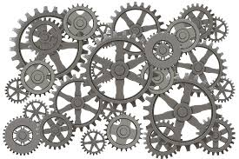
A New Level of Interoperability
In the past years we have focused on interoperability at the repository level, now we need interoperability at the resource level (and below)
Resources need to talk to each other to be reusable, this in turn will make the repositories the basis of a global scholarly ecosystem
By Andrea Bollini and David Wilcox

Slide 18
Three Vertical Discovery Mechanisms
Batch – Transferring bulk data
Navigation – Helping robots to find resources in repositories by means of navigation
Notification – Enabling robots to subscribe to changes in repositories
By Petr Knoth
18
Notes:
There is no requirement to store them in the same repository for them to utilized by the same service(s), logically grouped, etc.
assumed could interact with the resources as if they were within the same physical repository

Slide 19
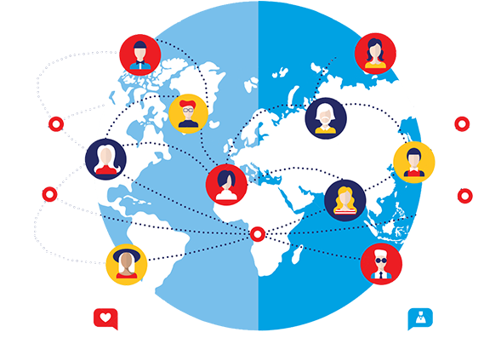
Global Sign On
Global sign on
As a user, I want my repository to recognize me and other users so that I can be connected with other users who I know, leave comments and be informed of content that is of interest to me.
By Petr Knoth
19
Notes:
There is no requirement to store them in the same repository for them to utilized by the same service(s), logically grouped, etc.
assumed could interact with the resources as if they were within the same physical repository

Slide 20
Transparent Social Network over Repositories
Annotation
Commenting/social interaction
Notification feed
Recommender systems
All in a transparent and distributed environment
By Petr Knoth
20
Notes:
There is no requirement to store them in the same repository for them to utilized by the same service(s), logically grouped, etc.
assumed could interact with the resources as if they were within the same physical repository

Slide 21
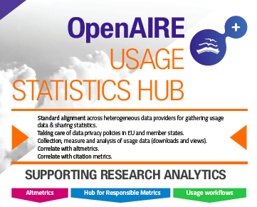
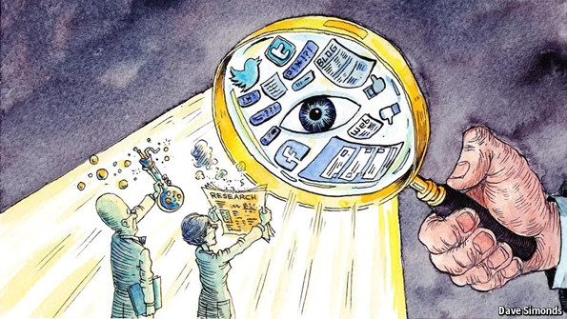
Research Assessment
Comparing usage
Peer-reviews
Open citations
Open Peer Review
21
Notes:
There is no requirement to store them in the same repository for them to utilized by the same service(s), logically grouped, etc.
assumed could interact with the resources as if they were within the same physical repository

Slide 22
Final Report
Recommendations of the COAR Next Generation Repositories Working Group (November 2017)
  https://www.coar-repositories.org/files/NGR-Final-Formatted-Report-cc.pdf (pdf)
  http://ngr.coar-repositories.org/ (website)
  https://github.com/coar-repositories/ngr/tree/master/webroot/content/behaviour (GitHub)

Slide 23
Behaviors and Technical Recommendations
Exposing Identifiers Declaring Licenses at the Resource Level Discovery Through Navigation Interacting with Resources (Annotation, Commentary, and Review) Resource Transfer | 6. Batch Discovery 7. Collecting and Exposing Activities 8. Identification of Users 9. Authentication of Users 10. Exposing Standardized Usage Metrics 11. Preserving Resources
Notes:
Based on the principle and design assumption, we defined 11 technical recommendation like this.

Slide 24
Technologies, Standards and Protocols
Activity Streams 2.0 COUNTER Creative Commons Licenses ETag HTTP Signatures IPFS International Image Interoperability Framework Linked Data Notifications ORCID and other author IDs OpenID Connect | 11. ResourceSync 12. SUSHI 13. SWORD 14. Signposting 15. Sitemaps Social Network Identities Web Annotation Model and Protocol WebID and WebID/TLS WebSub Webmention
Notes:
In order to develop NGR as the repository functionality, we mapped standards and protocols.

Slide 25
1. Exposing​ ​Identifiers
User​ ​stories
  As a web reference manager, annotation tool, or crawler, when I encounter a landing page or any other web resource that is part of a scholarly object, I need to easily identify the associated persistent ​HTTP ​URI ​for ​the ​resource, ​so ​that ​I ​can ​retrieve ​it.
Technologies
  Signposting​

Slide 26
2.​ ​Declaring​ ​Licenses​ ​ at​ ​the​ ​Resource​ ​Level
User​ ​stories
  As a machine or human user, I need to easily and uniformly identify the licensing and re-use conditions ​of ​a ​scholarly ​resource, ​so ​that ​I ​know ​what ​I ​am ​allowed ​to ​do ​with ​it.
Technologies
  Creative​ ​Commons​ ​Copyright​ ​Licenses​
  Signposting

Slide 27
3.​ ​Discovery​ ​through​ ​Navigation
User​ ​stories
  As a human or machine user, I want to easily and uniformly discovery the metadata in a repository ​record, ​so ​that ​I ​can ​ascertain ​the ​relevance ​of ​the ​resource.
  As a repository manager, I want to be able to access the metadata in my repository in real time through ​an ​API ​in ​order ​to ​build ​views ​or ​services ​on ​any ​platform ​using ​the ​data.
Technologies
  Signposting

Slide 28
4.​ ​Interacting​ ​with​ ​Resources​
​(Annotation,​ ​Commentary,​ ​and​ ​Review)
User​ ​stories
  As a user, I want to be able to comment or review the work of my colleagues and have those reviews (and reviewers) publicly available to other readers, so that the quality of a resource can be ​assessed ​by ​others.
  As a researcher, I want to connect content from different repositories to create meaningful aggregation such as study paths or virtual reconstruction combining separated and distributed digital ​objects ​(images, ​3d ​objects).
  As a funding institution, I want to be able to access the reviews (and metrics) of resources created ​by ​specific ​authors.
Technologies
  Activity​ ​Streams​ ​2.0
  Web​ ​Annotation​ ​Model​ ​and​ ​Web​ ​Annotation​ ​Protocol
  International​ ​Image​ ​Interoperability​ ​Framework​ ​(IIIF) ​

Slide 29
5.​ ​Resource​ ​Transfer
User​ ​stories
  As a human or machine user, I want to be able to mine the collective full text content of repositories ​to ​discover ​new ​relationships ​and ​make ​new ​discoveries.
Technologies
  IPFS
  ResourceSync
  SWORD

Slide 30
6.​ ​Batch​ ​Discovery
User​ ​stories
  As a user, I want to discover repository materials of interest via aggregators or other search services such ​as ​BASE, ​CORE, ​OpenAIRE, ​and ​so ​on.
  A ​text ​mining ​application ​wants ​to ​discover ​the ​HTML ​or ​PDF ​versions ​of ​scholarly ​publications.
  A digital preservation application wants to discover all resources that pertain to a scholarly object, including all its constituent resources in various representations, bibliographic information, ​license ​information, ​and ​a ​persistent ​identifier.
Technologies
  ResourceSync
  Signposting
  Sitemaps​ ​
Notes:
Here is a example of no.6 batch discovery
In each case, we made user stories like this.
In the batch discovery,
And then necessity technologies are resourceSync, Signposting and sitemaps.

Slide 31
7.​ ​Collecting​ ​and​ ​Exposing​ ​Activities
User​ ​stories
  As a repository manager, I want my repository to be automatically notified about new or modified relevant objects and metadata, so that I can have a more complete and accurate collection.
  As ​a ​user, ​I ​want ​to ​receive ​recommendations ​about ​content ​that ​is ​of ​potential ​interest ​to ​me and ​related ​to ​my ​work, ​so ​I ​increase ​my ​knowledge ​in ​my ​field.
  As a repository manager I want other systems to be notified of changes made to my collection to ensure ​that ​records ​are ​standardized ​across ​various ​locations.
  As ​an ​author, ​I ​want ​to ​be ​informed ​as ​soon ​as ​my ​paper ​gets ​cited, ​my ​dataset ​is ​re-used, ​etc.
  A a repository manager, I want to know when web resource link to resources in my repository. That ​way, ​I ​can ​create ​links ​back ​to ​those ​resources ​and ​support ​discovery ​of ​related ​resources.
Technologies
  Activity​ ​Streams​ ​2.0
  Linked​ ​Data​ ​Notifications
  ResourceSync​ ​Change​ ​Notifications
  Signposting​
  Webmention​
  WebSub

Slide 32
8.​ ​Identification​ ​of​ ​Users
User​ ​stories
  As a user, I want my repository to recognize me and others so that I can be connected with other users ​who ​I ​know, ​leave ​comments ​and ​be ​informed ​of ​content ​that ​is ​of ​interest ​to ​me.
  As a user, I want to be able to discover new research outputs related to my interest, both pro-actively when browsing as well as in the form of notifications, regardless of the place in which ​they ​are ​stored.
  As ​a ​user, ​I ​want ​to ​receive ​recommendations ​about ​content ​that ​is ​of ​potential ​interest ​to ​me and ​related ​to ​my ​work, ​so ​I ​increase ​my ​knowledge.
  As a user, I want to have access to a global, cross-repository social feed so that I am informed about ​activities ​in ​which ​I ​have ​registered ​an ​active ​interest.
  As a user, I want to know when one of my social media contacts added a document, someone commented on a paper in a feed I was subscribed to, an open review has been provided on a paper I have read, a new dataset has been attached to a paper I am watching, a paper has been published ​based ​on ​a ​dataset ​I ​have ​used, ​etc.
  As a user, I want to be able to discover and identify important people, relevant scientific methods, conference/journal/meetup venues, funding opportunities, etc. in the research field I am ​interested ​in.
Technologies
  ORCID
  Social​ ​Network​ ​Identities
  WebID

Slide 33
9.​ ​Authentication​ ​of​ ​Users
User​ ​stories
  As a user, I want the repository to recognize me and others so that I can be connected with other users ​who ​I ​know, ​leave ​comments ​and ​be ​informed ​of ​content ​that ​is ​of ​interest ​to ​me.
  As a repository manager, I want to avoid that users interact in inappropriate ways with content in my repository. Requiring users to identify themselves and verifying the claimed identity with the ​identity ​provider ​reduces ​the ​risk.
Technologies
  HTTP​ ​Signatures
  OpenID​ ​Connect​ ​1.0
  WebID/TLS

Slide 34
10.​ ​Exposing​ ​Standardized​ ​Usage​ ​Metrics
User​ ​stories
  As an author, I want to know how often my paper, dataset or other resource is being used, and to be able to compare that with other papers of my peers so that I have an objective, standardized ​way ​of ​assessing ​the ​impact ​of ​my ​work.
  As a funder, I want to use repository metrics as one measure that will help evaluate the impact of the ​research ​I ​fund.
  As ​a ​research ​administrator, ​I ​wish ​to ​use ​a ​broader ​variety ​of ​measures ​to ​assess ​impact including ​repository ​metrics ​and ​incorporate ​them ​in ​my ​reports ​that ​assess ​the ​impact ​of ​the research ​I ​support.
Technologies
  COUNTER​
  SUSHI​
  ETag​

Slide 35
11.​ ​Preserving​ ​Resources
User​ ​stories
  As ​a ​scholar ​or ​institution, ​I ​want ​my ​research ​outputs ​to ​be ​available ​over ​the ​long ​term ​and remain ​as ​a ​permanent ​part ​of ​the ​scholarly ​record.
  I also want to know that my article will be recoverable in the event a repository loses its copy of my ​work. ​I ​may ​also ​be ​interested ​in ​searching ​archival ​holding.
Technologies

Slide 36
Next Generation Repositories
Behaviours and Technical Recommendations
Technologies, Standards and Protocols
Two examples…
Notes:
For those who are not familiar with technological things.

Slide 37
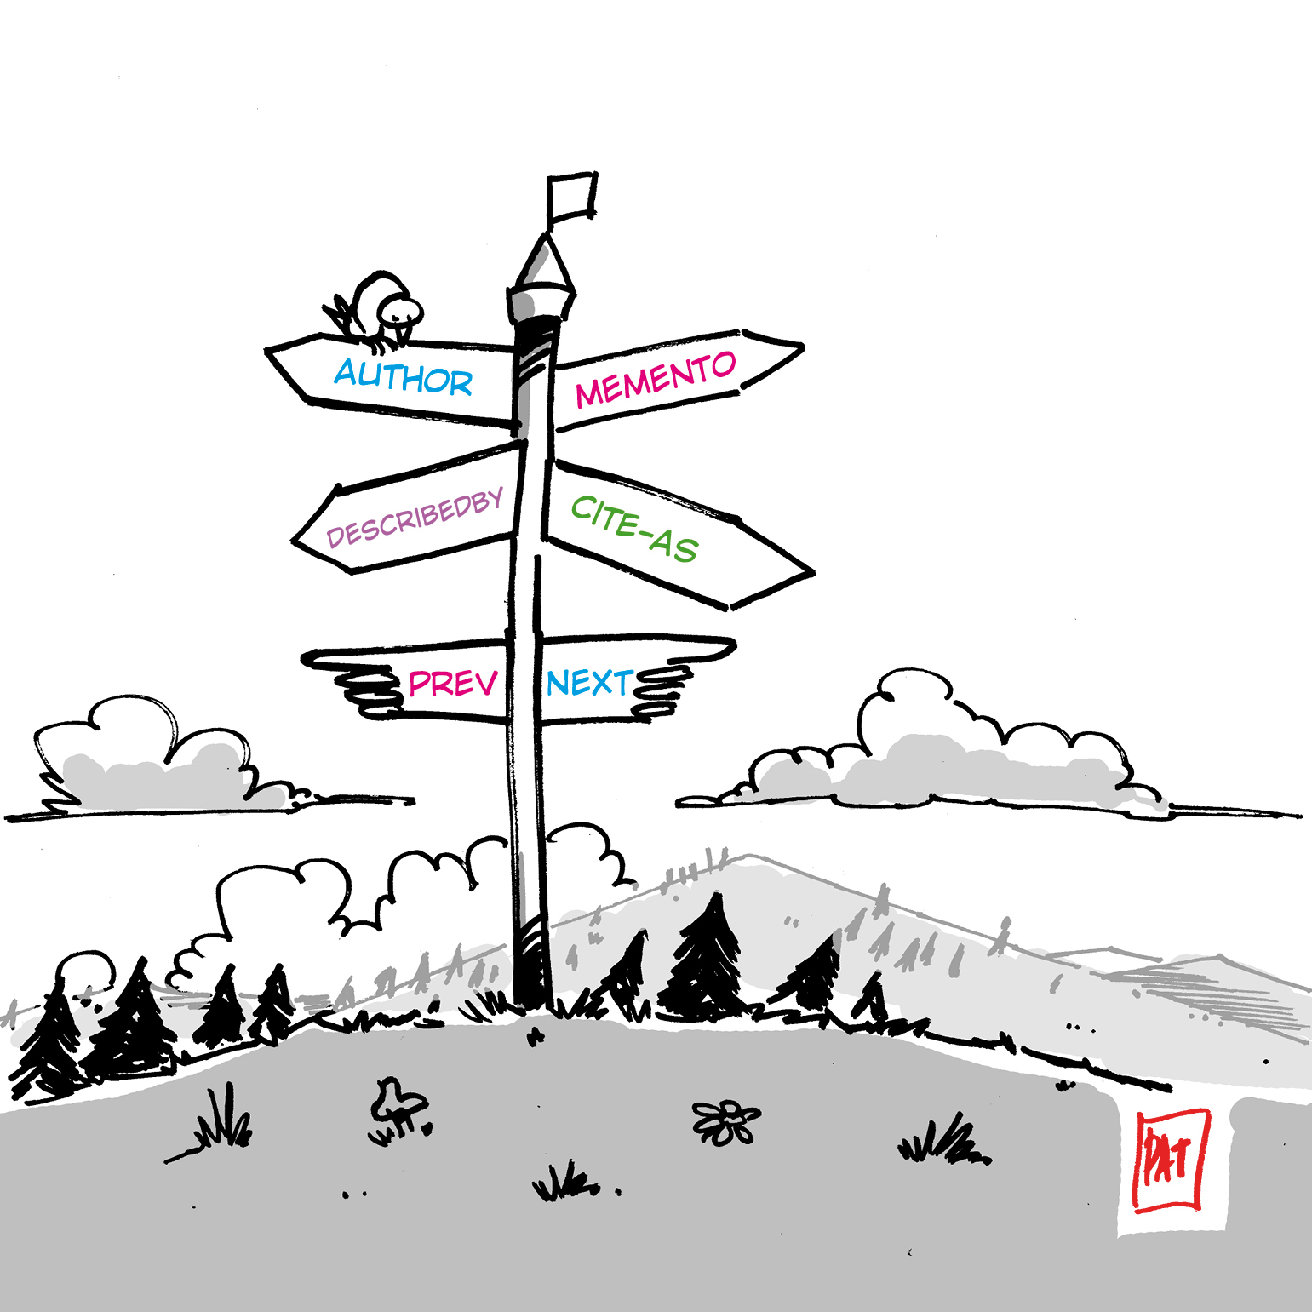
Signposting
An approach to make the scholarly web more friendly to machines exposing relations as Typed Links in HTTP Link headers
The following discovering patterns are currently defined:
Author
Bibliographic Metadata
Identifier
Publication Boundary
Notes:
The signposting is an approach to make …
And right now, following discovering patterns are defined.

Slide 38
ResourceSync
Successor of the OAI-PMH protocol and much more…
Faster, reliable and scalable
Allows real-time notification
(and recovering of missed messages)
Drives resource synchronization:
content and metadata are both managed
http://www.openarchives.org/rs/1.1/resourcesync
Notes:
Second example is the resourceSync.
This is the successor of the OAI-PMH protocaol and has much more good feature.
It faster, …

Slide 39
Next Steps
Implementation of technologies in repository platforms
Development of network or hub services
Ongoing monitoring of new technologies, standards and protocols
Notes:
As I said before we are now in the implementation stage.

Slide 40

Next Steps 1
Implementation of technologies in repository platforms
Working with open source platforms to implement recommendations
Organizing regional projects to support development costs and contribute resources: OpenAIRE Advance (Europe), National Institute of Informatics (Japan), US NGR Implementers Group
Notes:
We are now working with open source platforms.

Slide 41
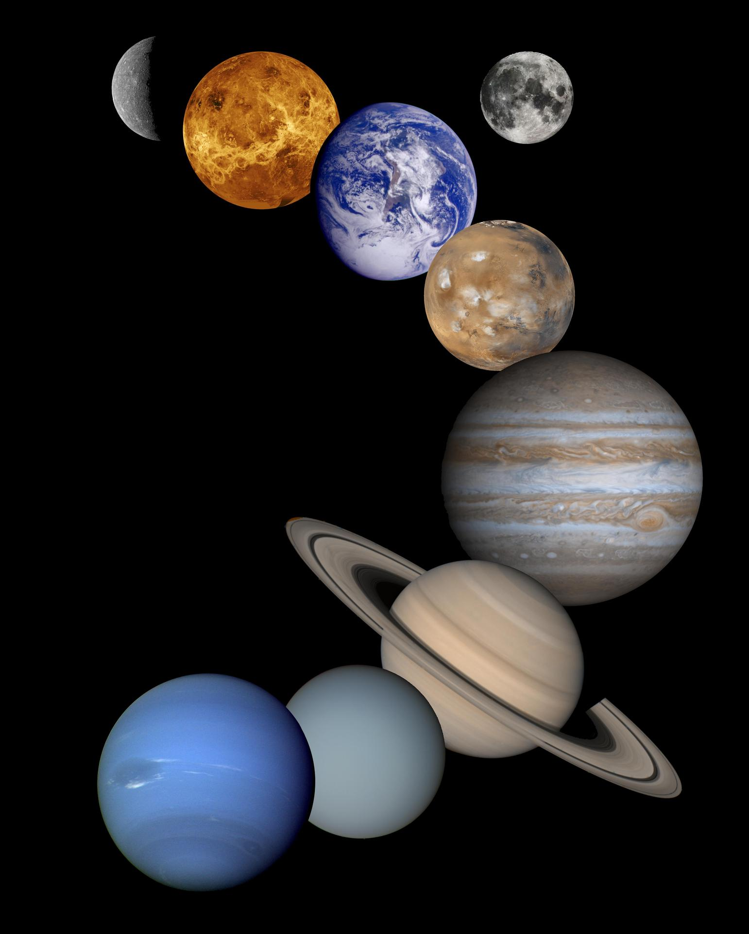
Next Steps 2
Development of network or hub services
Aligning Repository Networks Accord, May 2018
Technical and Strategic Meeting of 20 Repository Networks, May 14 & 15, 2018 in Hamburg, Germany
Pilot Projects 2nd half 2018 (Open Peer Review, Common Standards for Usage Statistics, Recommender Systems)
Notes:
And then move on to the development of network or hub services.

Slide 42
Next Steps 3
Ongoing monitoring of new technologies, standards and protocols
COAR Next Generation Repositories Editorial Group
-Andrea Bollini -Kathleen Shearer
-Rick Johnson -Herbert Van de Sompel
-Paolo Manghi -Paul Walk
-Eloy Rodrigues -Kazu Yamaji

Slide 43
Domestication of NGR
What we are doing in Japan
Review Japanese IR Activity in the Past
Summarize Next Challenge
Understand NGR Concept
Mapping Our Challenge with NGR
Define 12th and more Behaviors if Necessary
Create the Future Repository Network
Notes:
The important thing is not just follow NGR itself.
How to under stand their thought and concept about NGR in the sense of your community is much more important
In our case, ...

Slide 44
Thanks and questions!

